Slide 1
Mental Health Trends in Minnesota An Analysis of Historical Data
By: Mohamud Bune

Slide 2
Overview
-The importance of analyzing mental health trends cannot be overstated, as it helps in understanding the prevalence and impact of mental health issues over time.
- The main goal of this project is to identify trends, regional differences, and factors affecting mental health outcomes in Minnesota.

Slide 3
Dataset Overview
-Source: The data was sourced from the Minnesota Department of Health, which provides reliable and comprehensive data on mental health incidents.
- Description: The dataset includes historical data on mental health incidents, covering various years, regions, and age groups within Minnesota.

Slide 4
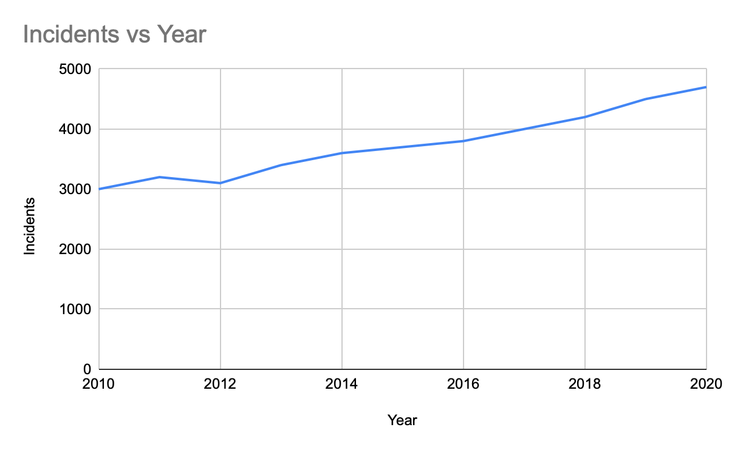
- This chart shows the trend of mental health incidents over the years.
-It helps in understanding whether the incidents are increasing, decreasing, or remaining stable over time.

Slide 5
Trends Over Time
- The analysis revealed that mental health incidents have shown an increasing trend over the years.
- Notable spikes in specific years could indicate external factors affecting mental health, such as economic downturns or significant social events.

Slide 6
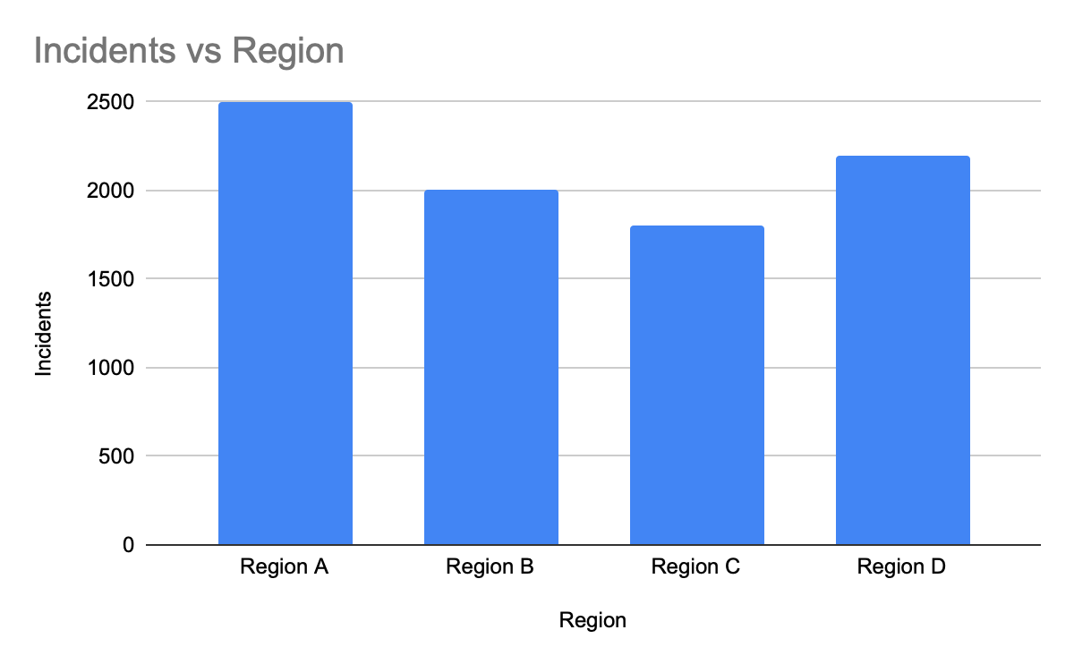
Regional Analysis
- The analysis showed significant differences in mental health incidents across various regions in Minnesota.
- For example, Region A had the highest number of incidents, while Region C had the lowest.
- These differences could be due to factors such as availability of mental health services, socioeconomic conditions, and population density.

Slide 7
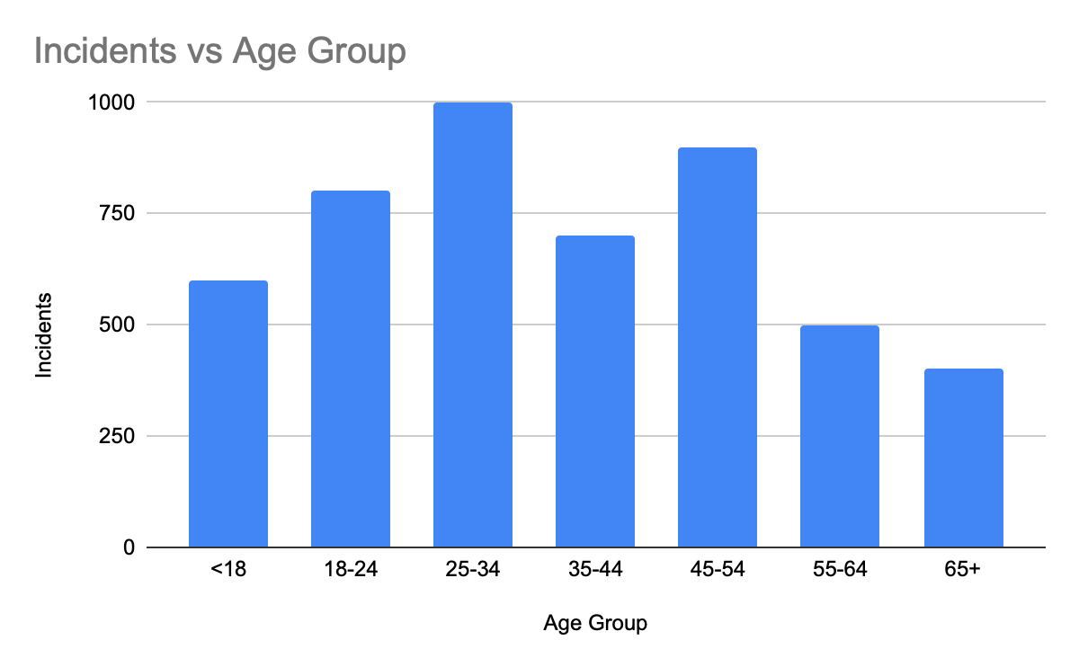
Age Group Analysis
-The highest number of incidents was observed in the 25-34 age group, indicating that young adults are particularly affected by mental health issues.
- The lowest number of incidents was found in the 65+ age group, which could be due to underreporting or different coping mechanisms in older adults.
- This distribution helps in targeting specific age groups for mental health interventions.

Slide 8
Summary of Findings
Summary of Findings:
- Mental health incidents are on the rise in Minnesota, with significant regional and age group differences.
- The data highlights the need for targeted mental health initiatives and improved access to services.
- Final thoughts: Addressing mental health issues requires a comprehensive approach involving policymakers, healthcare providers, and the community.

